Slide 1
INFERENCE FOR PATIENTS THAT ARE SUSPECTS FOR COVID-19 DISEASE
VINTILĂ ȘI FORMAȚIA

Slide 2
ABOUT THE PROJECT
It is no news that in the current times COVID-19 influenced our lives and became a common subject found everywhere around us. Given these circumstances, our goal is to help the medical system by building an app that finds the chance of infection with the new virus based on existing medical data

Slide 3
WHAT WE HAVE LEARNT
Teamwork
Communication
Time management
Roles existing in real projects of the industry and activities associated
Version control system

Slide 4
TECHNOLOGIES USED
Python
Ludwig
Flask
Angular

Slide 5
OUR APPROACH
We preprocessed the data in order to have all the relevant information in a standardized form of our choice
We got rid of irrelevant data that may harm our model’s training (patients with not enough information submitted)
We partitioned the dataset in two parts: 80% of records were used for training and 20% of records were used for testing
We trained the model
We tested the model
We created an user friendly interface that contains our results in a readable form

Slide 6
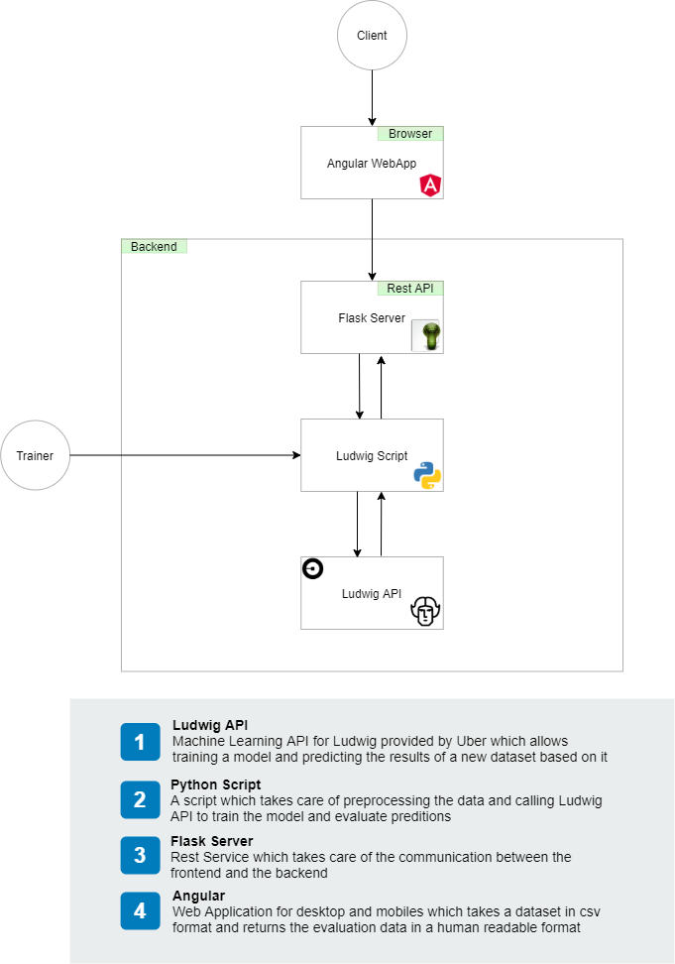
ARCHITECTURAL DIAGRAM

Slide 7
PREREQUISITES
Install Python3
Run the following commands in an elevated Powershell/CMD window
python -m pip install --upgraded pip
pip install ludwig
(Optional step) If you’re using Windows on build 2004 you have to run:
pip install numpy==1.19.3
Also run the following commands:
python -m spacy download en
pip install flask
Install Node.js, LTS. Make sure to also install npm and select Add to PATH

Slide 8
INSTALLATION
Navigate to /sources/Angular_UI in a PowerShell elevated prompt
Run the following command:
npm ci

Slide 9
HOW TO RUN - TRAINING & EVALUATION
TRAINING
python .\sources\main.py train .\input\training.dataset.csv .\output\preprocessed.dataset.csv .\sources\model_definition_train.yaml
EVALUATION
python .\sources\main.py evaluate .\results\covid_inference_train\model .\input\testing.dataset.csv .\output\preprocessed-exp.dataset.csv .\sources\model_definition_evaluate.yaml

Slide 10
HOW TO RUN - OVERALL APPLICATION
BACKEND
Navigate to the project's root in a PowerShell prompt
Run the following command:
python sources/server.py
FRONTEND
Navigate to the /sources/Angular_UI folder in a PowerShell prompt
Run the following command:
npm start
Access the website application at the link: http://localhost:4200/covid-inference

Slide 11
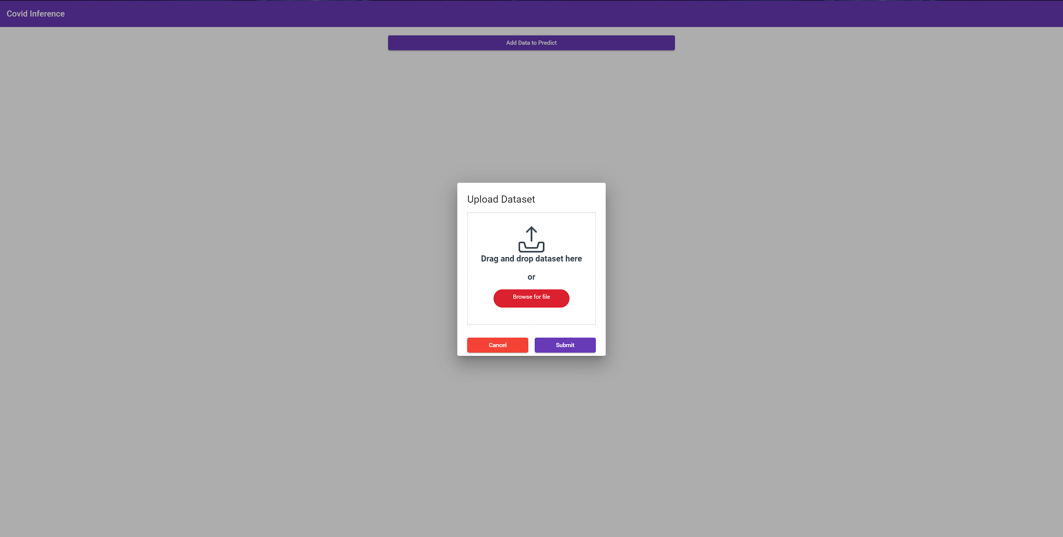
HOW DOES IT LOOK?

Slide 12
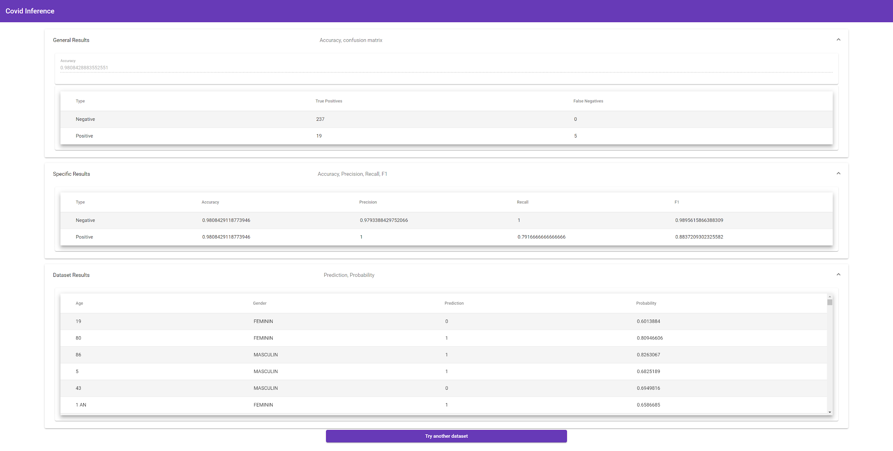
HOW DOES IT LOOK?

Slide 13
DEMO TIME

Slide 14
TEAM ROLES
Bengescu Paul - Developer / Florin Minune
Ciudin Andreea-Alexandra - Developer / Laura Vass
Cojocaru Cristina-Gabriela - Team Leader / Prințesa de Aur
Petrescu Ioana-Raluca - Analyst / Petrică Cercel
Vintilă Marius-Mihai - Project Manager / Șușanu

Slide 15
EXTRA DOCUMENTS
Preprocess rules
Meeting minutes
Architectural Diagram
Additional screenshots
Readme

Slide 16
THANK YOU!

